Slide 1
Data Sets
Math from the Real World

Slide 2
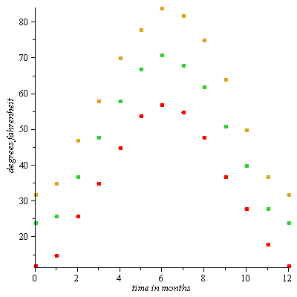
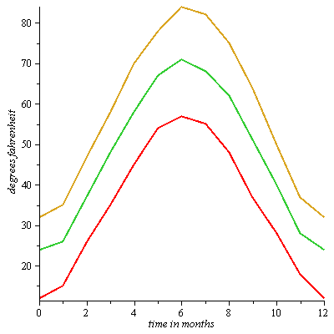
Hot and Cold in Mount Vernon
Avg. low, mean, high temps
Connecting the dots

Slide 3
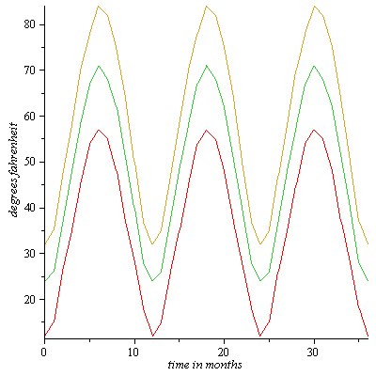
Hot and Cold in Mount Vernon
Now we repeat the pattern over three years.
This allows us to predict average temperatures in the future.

Slide 4
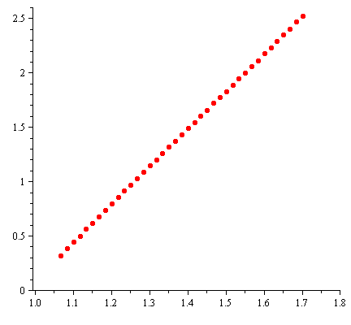
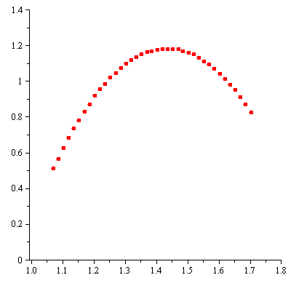
Ball Toss
Horizontal pos. vs. time
Vertical pos. vs. time

Slide 5
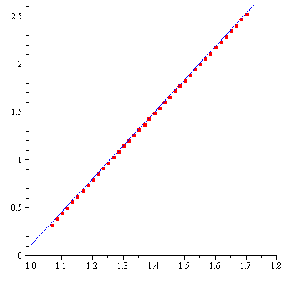
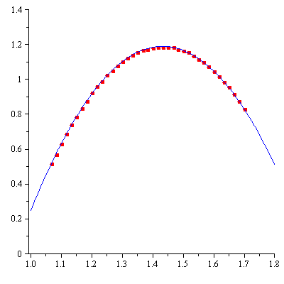
Ball Toss
Horizontal pos. vs. time
Vertical pos. vs. time

Slide 6
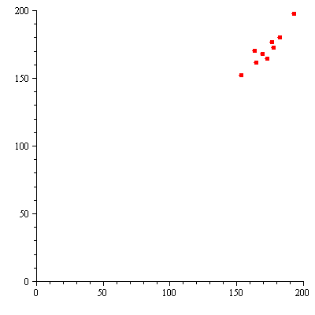
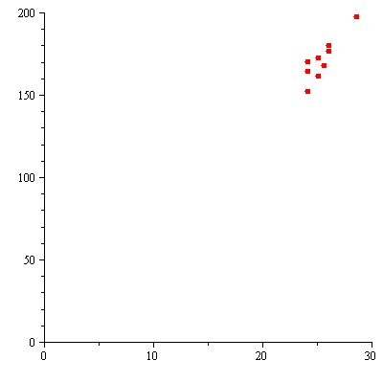
Body Proportions
Armspan vs. height (cm.)
Footlength vs. height (cm.)

Slide 7
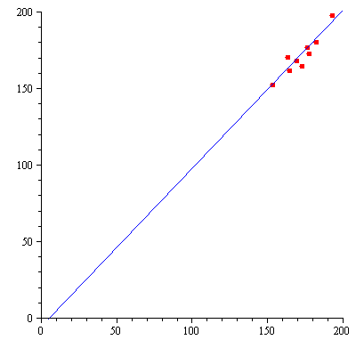
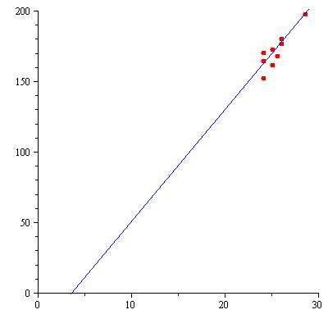
Body Proportions
Armspan vs. height (cm.)
Foot length vs. height (cm.)

Slide 8
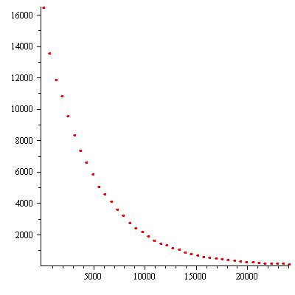
Radioactive Decay (Indium)
Thanks to Mr. K. in the Physics lab for giving us this data.
The data were generated from the decay of indium foils that were exposed to our neutron source and counted with a Geiger counter .

Slide 9
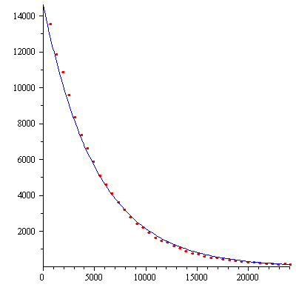
Radioactive Decay (Indium)
Thanks to Mr. K. in the Physics lab for giving us this data.
The data were generated from the decay of indium foils that were exposed to our neutron source and counted with a Geiger counter .

Slide 10
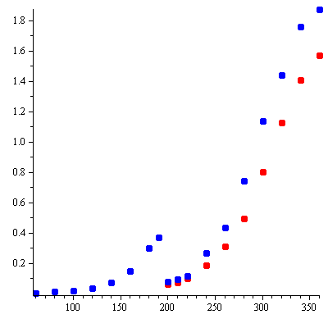
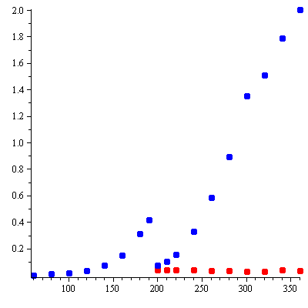
Bacteria Growth

Slide 11
Bacillus subtilis growth curve data
Thanks to Prof. Slonczewski in the biology department for giving us this data.
Bacteria were placed in media with pH of 6 and 7.4 and allowed to grow. Then they were “thinned out into fresh media of varying pH (6 to 6 and 7.4; 7.4 to 7.4 and 8.8) to see which pH shift most negatively affected the growth.

Slide 12
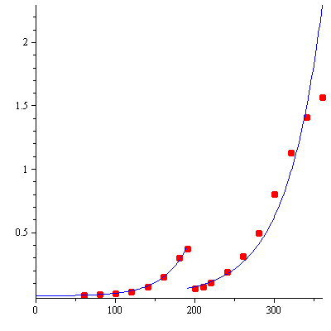
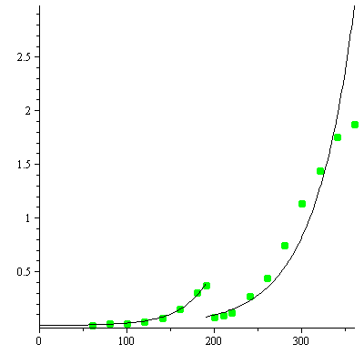
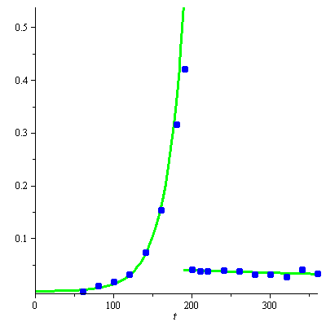
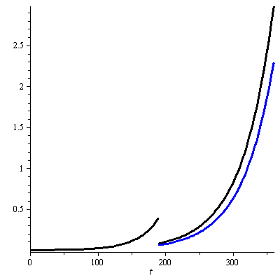
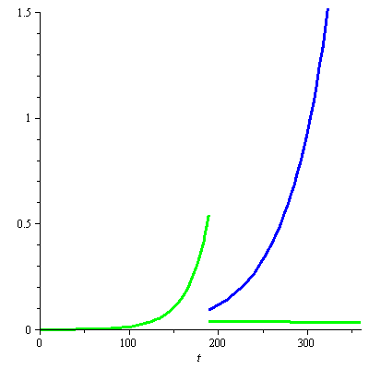
pH 6 to 6
and 7.4
pH 7.4 to 7.4
and 8.8
Conclusions?

Slide 13
The “real” world gives us data.
We use the data sets to construct mathematical models
We use mathematics to study the models
We draw conclusions about the real world the model

